Slide 1

Blockchain: Decentralizing the Future
Blockchain technology is revolutionizing industries by creating a decentralized, secure, and transparent record of digital transactions. This innovative system holds the power to transform the way we exchange value, track assets, and execute agreements, ushering in a new era of trust and efficiency.
AA
by Snigdha K 22071A67C0

Slide 2
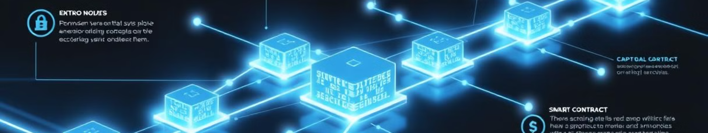
Blockchain Fundamentals: Distributed Ledger, Cryptography, Consensus
1
Distributed Ledger
2
Cryptography
3
Consensus Mechanisms
Blockchain operates on a decentralized network, where transactions are recorded on a shared, tamper-resistant ledger across multiple nodes.
Advanced cryptographic techniques, such as hashing and digital signatures, ensure the security and integrity of blockchain transactions.
Blockchain networks use consensus protocols to validate and approve transactions, ensuring the network's integrity without a central authority.

Slide 3
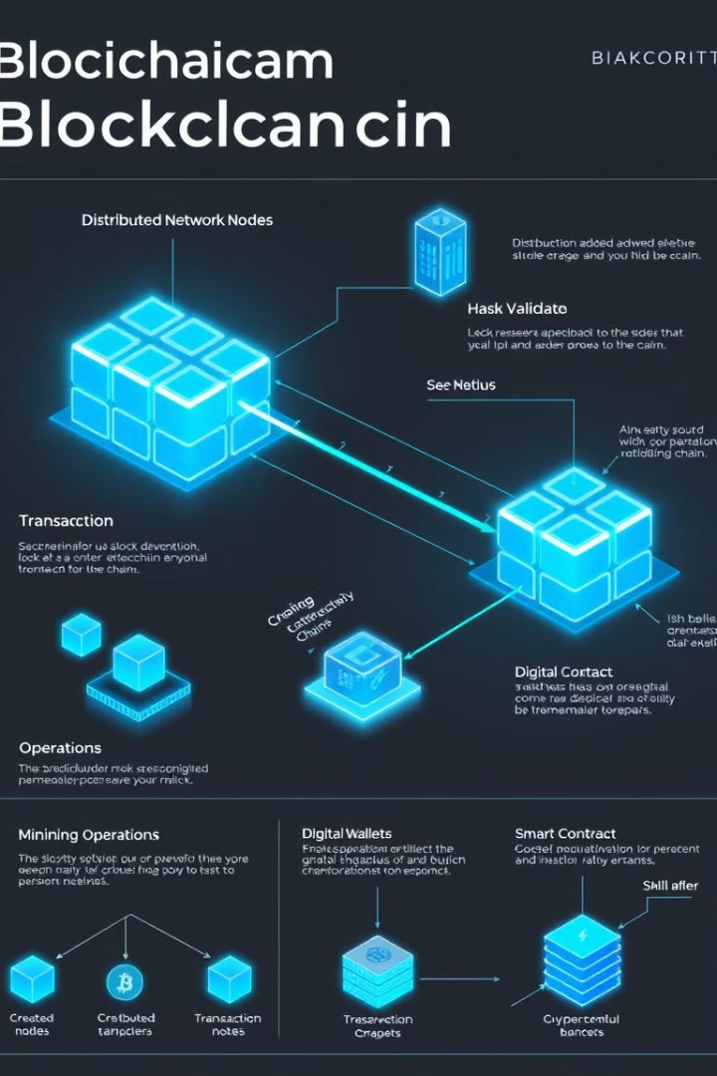
Block Creation and Validation Process
1
Transaction Collection
Transactions are gathered and grouped into a new block.
2
Hash Calculation
A unique cryptographic hash is generated for the new block.
3
Validation and Addition
The new block is validated by the network and added to the blockchain.

Slide 4
Real-World Blockchain Applications: Cryptocurrency, Smart Contracts, NFTs, Supply Chain
Cryptocurrency
Smart Contracts
Non-Fungible Tokens (NFTs)
Blockchain enables the creation and secure exchange of digital currencies, such as Bitcoin and Ethereum.
Self-executing, programmatic agreements that automatically enforce the terms of a contract, eliminating the need for a third party.
Unique digital assets stored on the blockchain, used for digital art, collectibles, and other ownership rights.

Slide 5
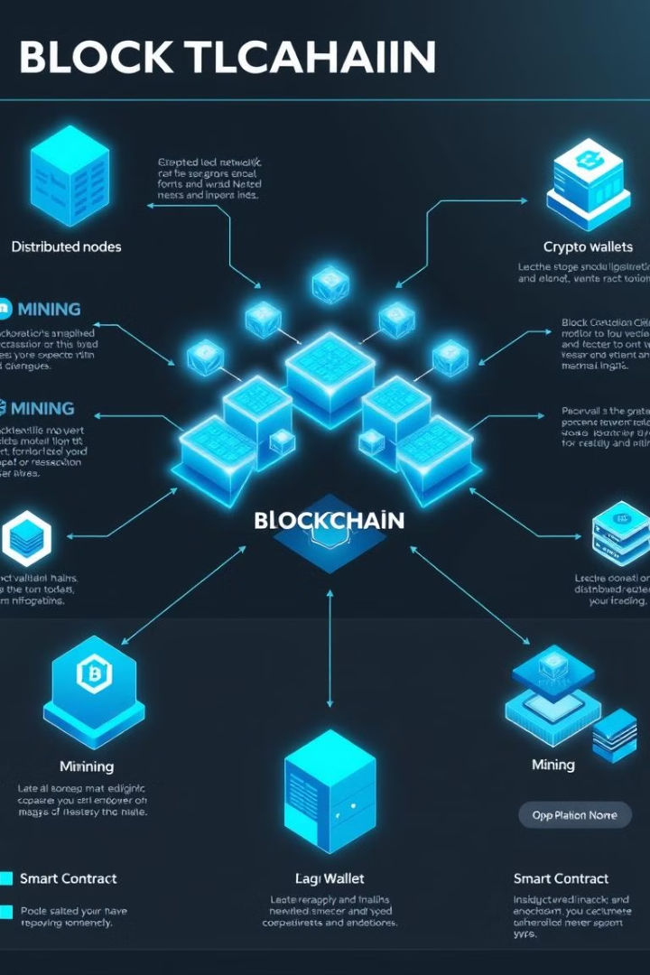
Blockchain Architecture: Diagrams and Explanations
Nodes
Distributed Ledger
Computers or devices that participate in the blockchain network and maintain the distributed ledger.
A shared, tamper-resistant record of all transactions and data on the blockchain.
Consensus Mechanisms
Core Components
Protocols that validate and reach agreement on the state of the blockchain, such as Proof-of-Work or Proof-of-Stake.
The essential elements of a blockchain system, including cryptography, smart contracts, and decentralized applications.

Slide 6
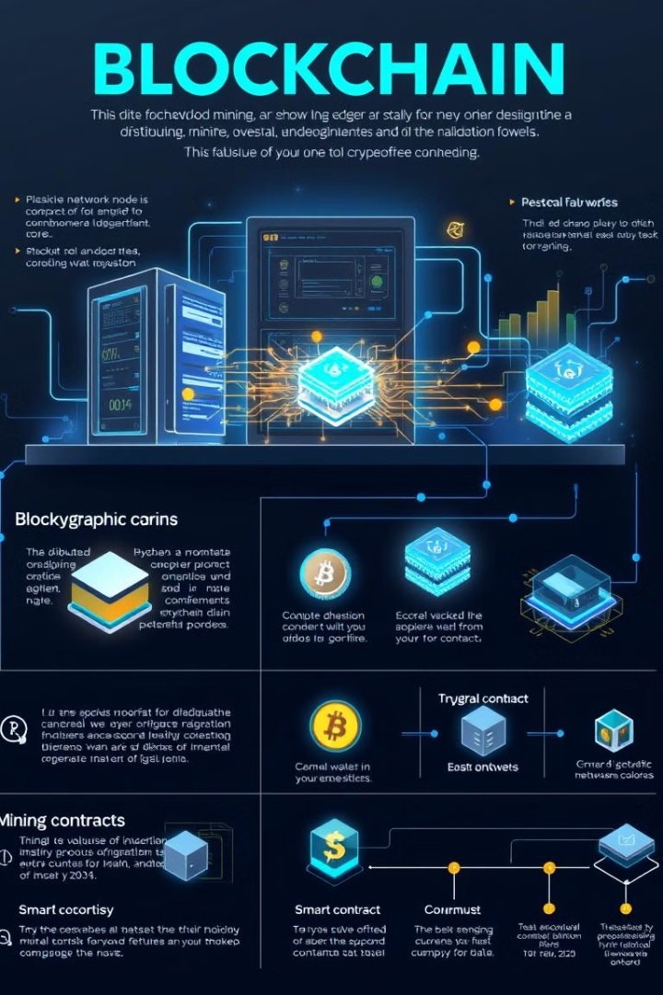



Blockchain Mining Process and Visuals
Transaction Gathering
Miners collect pending transactions into a new block.
Hash Calculation
Miners use computing power to solve the cryptographic puzzle and generate a valid block hash.
Validation and Reward
The new block is validated by the network and the successful miner is rewarded with cryptocurrency.

Slide 7
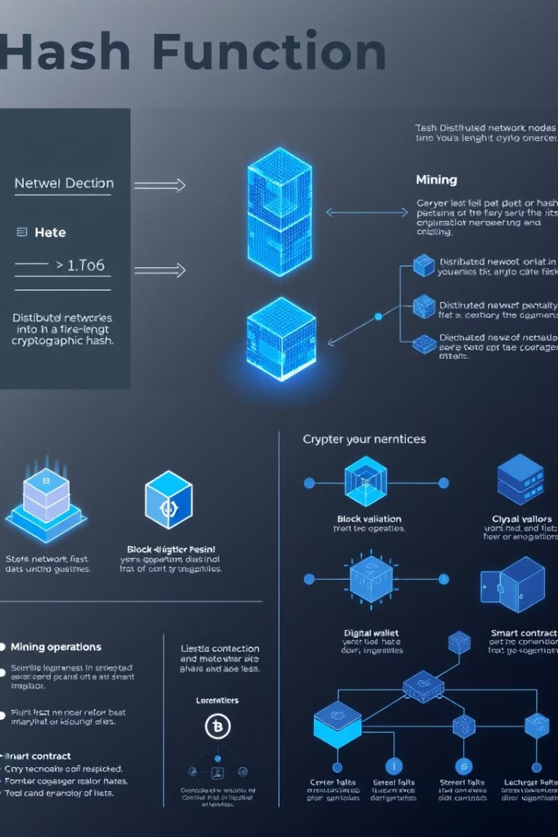
Hash Function Principles
1
Deterministic
2
Irreversible
The same input will always produce the same hash output.
It is computationally infeasible to derive the original input from the hash value.
3
Collision Resistant
It is extremely unlikely that two different inputs will produce the same hash.

Slide 8




Major Blockchain Platforms: Bitcoin, Ethereum, Solana
Bitcoin
Ethereum
Solana
The first and most well-known cryptocurrency, pioneering the blockchain technology.
A versatile blockchain platform that enables smart contracts and decentralized applications.
A high-performance blockchain network known for its scalability and low transaction fees.

Slide 9
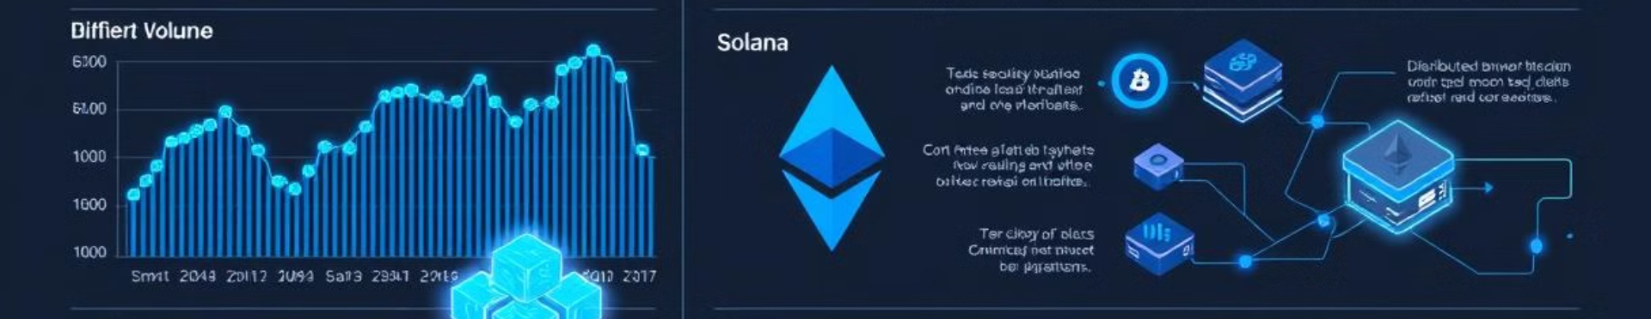
Platform Logos and Market Data
Platform
Market Cap
Trading Volume
Price
Bitcoin
$1.2 Trillion
$50 Billion
$65,000
Ethereum
$500 Billion
$25 Billion
$3,500
Solana
$50 Billion
$5 Billion
$200

Slide 10
Future Trends and Industry Adoption Predictions
Increased Mainstream Adoption
Advancements in Scalability
Innovative Use Cases
Blockchain will continue to enable new and transformative applications, from decentralized finance to supply chain management and beyond.
Blockchain technology is expected to see wider mainstream adoption across industries, driven by its benefits of transparency, security, and efficiency.
Ongoing research and development will lead to improvements in blockchain scalability, allowing for faster transaction processing and higher throughput.

